Slide 1
NIOS II EMULATOR Increment 3 Retrospective
Team 12
Team Members
Jake Ediger
Alex Michael
Alex Czarnick
Avinash Nooka
Raksharth Choudhary

Slide 2
Overview
Project Description
Design Goals & Tradeoffs
Subsystem Decomposition
Other Architectural Issues
Reflection

Slide 3
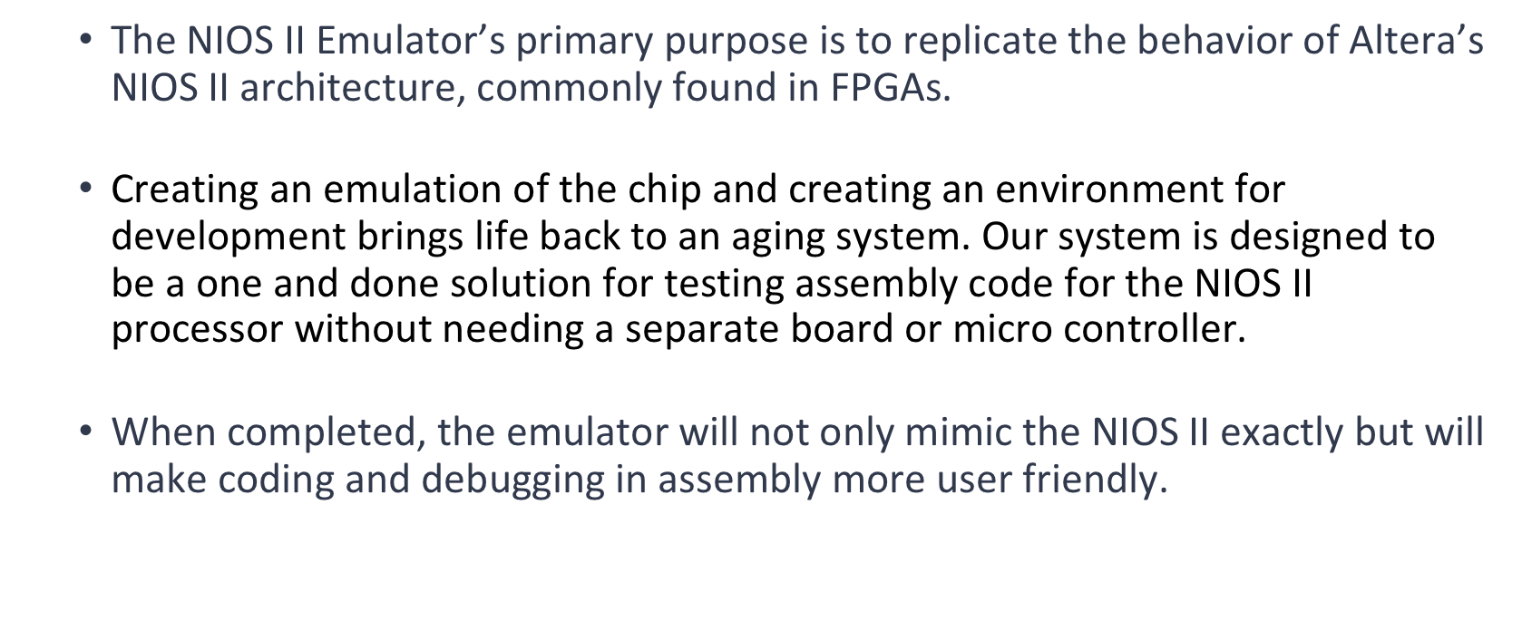
Project Overview

Slide 4
Overview
Project Description
Design Goals & Tradeoffs
Subsystem Decomposition
Other Architectural Issues
Reflection

Slide 5
Design Goals & Tradeoffs
Full functionality of NIOS II Emulator
System will be able to select a text file of assembly code from the user’s file system.
System will run assembly code according to NIOS II architecture, in which there is a 32 bit, little endian processor environment with 16 bit memory addresses and 32 general purpose registers.
Trade off: Although emulation of the NIOS II output is possible, working with specific parts of a processor may not be. If a student were trying to learn how how the inner parts of a processor work, an emulation may not be the best method.

Slide 6
Design Goals & Tradeoffs
2) Simplicity
The implementation of the system architecture will be far simpler simpler than the original NIOS II, using advances made in the field and the use of high-level programming languages.
Simplicity will be gauged by the ease in which instructions are implemented, as well as how memory is managed throughout execution.
The implementation language, javascript, comes with more packages than most high-level languages. Although packages can make things more complex in some situations, the use of packages for the emulator will make many operations (e.g. parsing) much more readable. It will also allow for less complex functions and fewer lines of code.

Slide 7
Design Goals & Tradeoffs
3) Maintainability
Maintaining the code may seem unnecessary due to the fact the NIOS II has been around and unchanging for some time, but it is very possible additional features will be added later on.
Future features would likely consist of additional capabilities that the NIOS II does not have, such as more advanced debugging or additional instructions not included in the original set.

Slide 8
Design Goals & Tradeoffs
4) User-Friendly
This NIOS II should have an appealing user interface that is easy to interact with and intuitive to use.
By updating the software user interface to something more comparable to what most people use on a daily basis today, the system will be much quicker to learn and use.
Trade off: User-friendliness applies only to those familiar with the NIOS II Architecture. If someone unfamiliar with NIOS II attempted to use the system, they would encounter significant difficulties in using or understanding the system.

Slide 9
Overview
Project Description
Design Goals & Tradeoffs
Subsystem Decomposition
Other Architectural Issues
Reflection

Slide 10
Subsystem Decomposition
Our subsystem decomposition involves 3 layers consisting of a Presentation layer, Application layer, and Database layer.
What do these layers provide?
Layer Functionality: Display program to user.
Application layer: Perform all functions of the software.
Database layer (non-persistent): Store all memory contents for access by the application layer.

Slide 11
A closer look at each layer
Presentation layer: GUI
The GUI obtains register values for displaying to the user.
Give user access to restart, start, and pause functionality.
Initialized first with the rest of the presentation layer.

Slide 12
Application layer (1/3)
File Reader
The File reader subsystem handles the access to the user’s file system, uploading the file, and parses instructions.
Validates file type, instructions, and legality of memory allocation.

Slide 13
Application layer (2/3)
Instruction Handler
Determining what instruction is being run, and using current register values retrieved from the register handler

Slide 14
Application layer (3/3)
Register Handler
Responsible for updating register values
Getting values for instruction handler, used to perform operations for given instructions

Slide 15
Database Layer (non-persistent)
Memory
Database Layer: non-persistent type
Holds input file
Holds instruction information
Holds register values

Slide 16
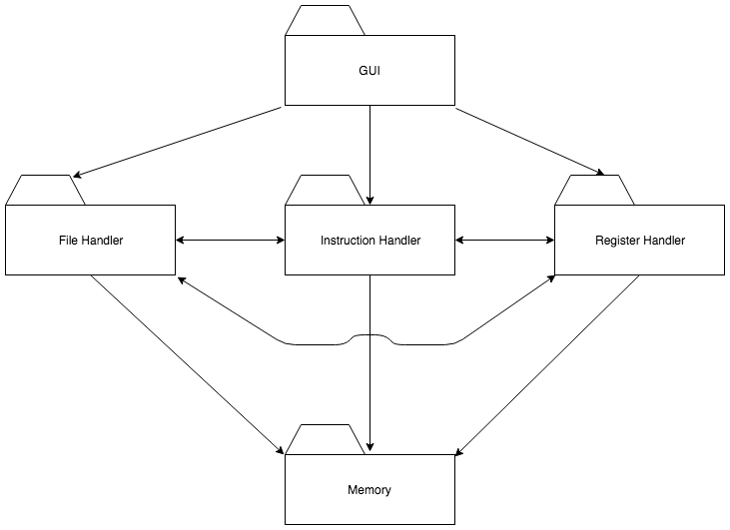
Design Goals & Tradeoffs
Use the diagram as a visual aid to discuss your subsystem decomposition and subsystem services
Place your architectural diagram on this slide
During your presentation, you should discuss how the architectural style you chose will help you satisfy your design goals

Slide 17
Overview
Project Description
Design Goals & Tradeoffs
Subsystem Decomposition
Other Architectural Issues
Reflection

Slide 18
Non-Persistent Memory
The non-persistent data will consist of hard coded memory, that only holds data during runtime. The memory is non-persistent, meaning no database holds the data once runtime is over. Rather than a database that stores information when the system is not running, the memory of this system will hold things like the input file and register values. Memory will be represented in an array. The inputted file, instructions, registers, etc, will be stored as indices in an array. The system will do basic CRUD operation to the array values. This will inturn emulate the NIOS II memory.

Slide 19
Overview
Project Description
Design Goals & Tradeoffs
Subsystem Decomposition
Other Architectural Issues
Reflection

Slide 20
Reflection What went well
The design goals for the emulator were fairly straightforward because of the language we are using.
The design goals were also easier to outline due to the fact that there isn’t a lot of different ways to emulate a NIOS II that would change the purpose.
Creating the UML diagram for the subsystem decomposition was easy since we used a 3 layer architecture

Slide 21
Reflection What didn’t go well
The subsystem decomposition had a slow start while we tried to find the right amount of ambiguity to apply when outlining the subsystems.
Selecting an architecture format took some time when we learned there was no apparent “best” way to create the system.
Deciding what we considered memory was different than a database model or persistent memory. The memory layer for our architecture is the emulation of the NIOS II memory system.

Slide 22
Reflection Something to Improve
More time spent on discussing ideas before working on them would have helped expedite the process.
Going through slides on the architecture helped us decide on one, so next time we will start with reading all the slides first.

Slide 23
Overview
Project Description
Design Goals & Tradeoffs
Subsystem Decomposition
Other Architectural Issues
Reflection

